Slide 1
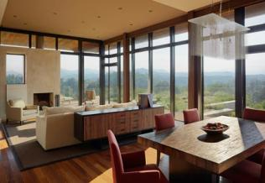
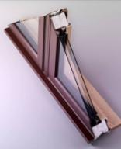
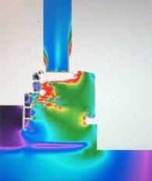
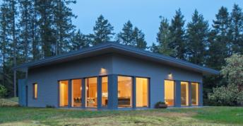
8th Annual North American Passive House Conference Very High Performance Passive House Windows Pittsburgh – October 2013

Slide 2
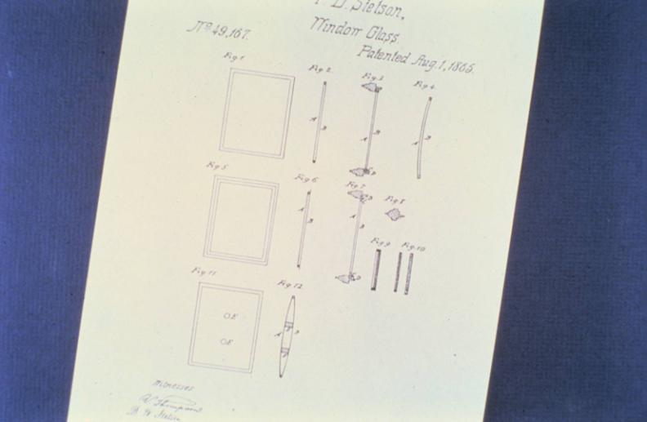
DOUBLE GLASS PATENT Thomas Stetson – 1865 144 Years Later: R-20 versus R-2 Insulating Value

Slide 3
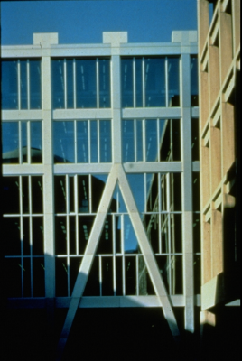
SUSPENDED COATED FILM (SCF) HISTORY Weightless Transition: Double To Triple Glazing (MIT: 1974 Research – 1990 Application)
1974 First SCF Produced “Vacuum Silver Deposition” On Clear Polyester
1190 MIT Rotch Library SCF Glazing (Super Insulation & UV Blockage)

Slide 4
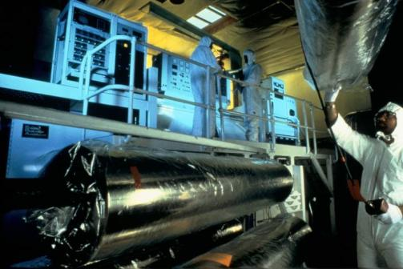
COATED FILM “PLANAR MAGNETRON SPUTERING” Heat Mirror Facility – Dresden, Germany
SCF Production: $18.5M Vacuum “Sputtering” Machine. SFC: 79” Wide By 5,000’ Long
10 Different SCF Technologies Address Residential, Institutional And Commercial Architecture

Slide 5
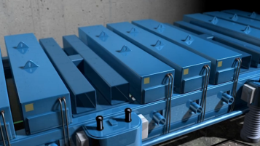
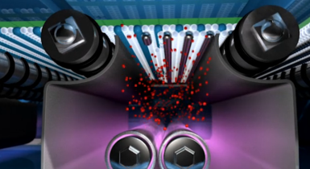
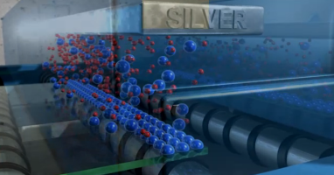
CARDINAL INSULATING GLASS
Vertically Integrated – From Melted Sand To Coated-Insulating Units
From: http://www.cardinalcorp.com/technology/reference/video-gallery/

Slide 6
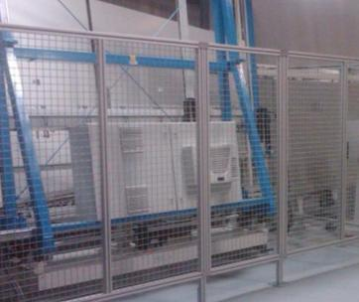
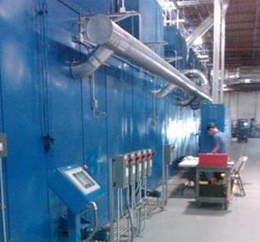
SOUTHWALL INSULATING GLASS CHICAGO
SCF Unit Production In 30-45 Seconds
First Truly Continuous Heat Mirror Production Worldwide

Slide 7
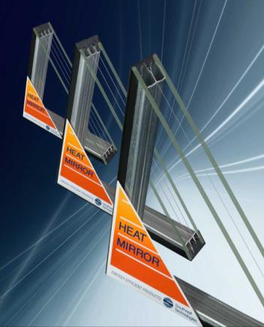
SOUTHWALL INSULATING GLASS CHICAGO
OEM Supplier To Passive House Window Manufacturers
80,000 SF Facility – Automated World Class SCF Production Line
Single / Double / Triple Heat Mirror Options
See: SouthwallGlass.com

Slide 8
SCF World Beyond Low-e

Slide 9
R = 1/U
SCF World Beyond Low-e

Slide 10
Performance Increase Due To Gas Filling Case #2: QuadPane

Slide 11
Optimal (approximate) Interspaces Air, Argon, Krypton & Xenon
Air: 1/2”
Argon: 1/2”
Krypton: 3/8 ”
Xenon: 1/4”

Slide 12
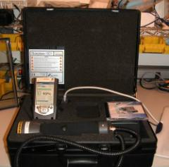
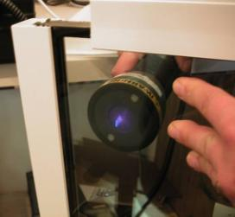
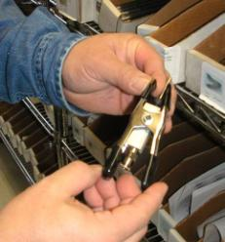
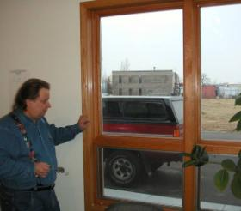
ARGON CONTAINMENT MONITORING
Argon Percentage Instantly Displayed
German Standard: Fill To 90+% - Maintain Gas Loss Below 1% Per Year
FDR Design (Buffalo, MN) 12-Year Argon Containment < ½% Per Year
Contact: Randi Ernst: FdrDesign.com

Slide 13
Frame Only U-Values
Frame-Only U-Values
From: "Residential Windows" (Carmody/Selkowitz/Arasteh/Heschong)
 | Low | High | Average
Aluminum (no break) | 1.7 | 2.4 | 2.05
Aluminum (thermal break) | 0.8 | 1.3 | 1.05
Carbon Steel | 0.40 | 0.57 | 0.49
Insulated Vinyl & Fiberglass | 0.2 | 0.4 | 0.30

Slide 14
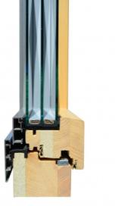
Zola Windows Passive House Windows ZolaWindows.com

Slide 15
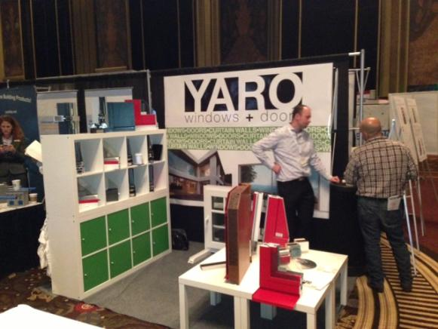
Yaro Windows Passive House Windows

Slide 16
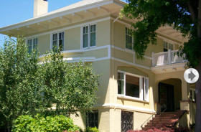
Wooden Window Passive House Certified WoodenWindow.com

Slide 17
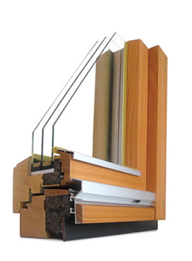
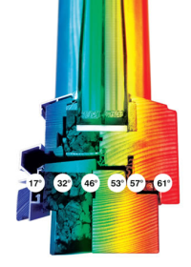
OptiWin Passive House Windows OptiWin-Usa.com

Slide 18
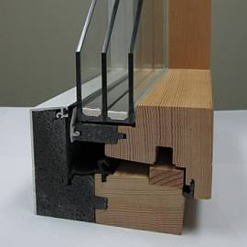
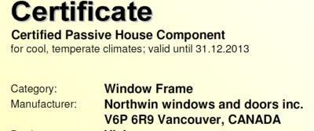
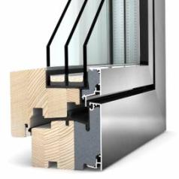
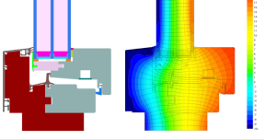
NorthWin Passive House Windows Northwin.com

Slide 19
Marvin Ultimate Windows Passive House Certified (Zone 3 & Marine South)
Glass Options: Tri-Pane & Quad Pane Heat Mirror®

Slide 20
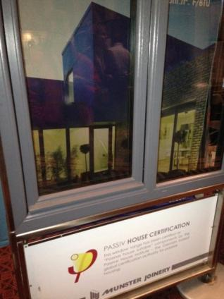
KlearWall / Munster Joinery (Ireland)

Slide 21
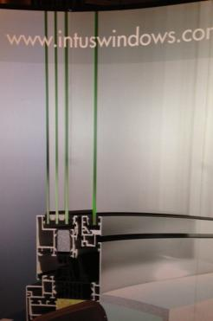
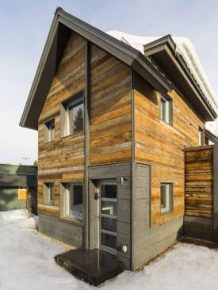
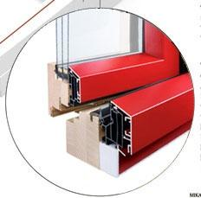
Intus IntusWindows.com

Slide 22
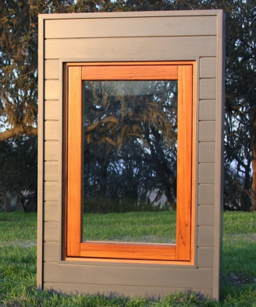
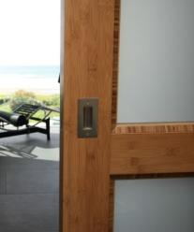
Casa Grande Woodworks Passive House Certified CasaGrandeWoodworks.com

Slide 23
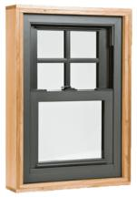
Alpen Windows Passive House Certified AlpenHpp.com
Glass Options: Alpenglass Heat Mirror Tri & Quad Pane

Slide 24
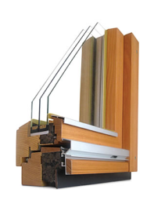
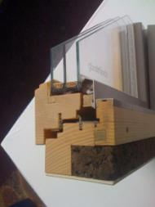
HIGH-END GERMAIN WINDOWS
Passive House Window: 4" Versus 2" Frame
Reference: Standard NFRC Casement: 47.2 x 59.1
Total Window (Frame) Area = 19.4 SF
 | 4" Frame | 2" Frame | Variance
Frame % Of Total Area | 28.2% | 14.5% | -49%
U-Value | 0.18 | 0.16 | -11%
SHGC | 0.39 | 0.45 | 15%
VT | 0.51 | 0.6 | 18%
Vision Area As % Of Total | 71.8% | 85.5% | 19%
Optiwin
GlasTrosch

Slide 25
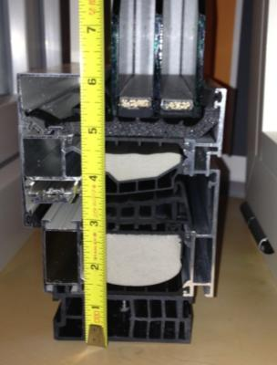
VISION AREA PERCENT
 | Net Vision Versus Opaque (Sash + Frame) Areas For NFRC Sizes
 |  | Casement |  | Fixed
 |  | 6” Frame |  | 6” Frame
 | W/ H | Less 6" |  | Less 6"
W | 23.6 | 11.6 | 47.2 | 35.2
H | 59.1 | 47.1 | 59.1 | 47.1
Area | 9.69 | 3.79 | 19.37 | 11.51
 | % Glass | 39% |  | 59%
 | % Opaque Sash + Frame | 61% |  | 41%
Optiwin

Slide 26
PHIUS Certified Window Performance Program
Graham Wright Graham@PassiveHouse.us

Slide 27
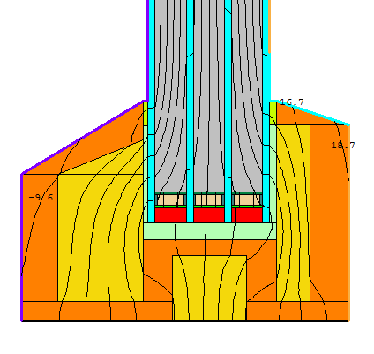
GRHAM WRIGHT R-9 Window Design
Frame
Wood and spray foam
Width 90 mm
Depth 140 mm (5.5”)
Glazing
4-pane, 90% Argon, 50 mm
Cardinal lo-e 180 and clear
Spacers
Chromatech Ultra F
“…I feel glazing is not the limiting factor for window performance at this time, but rather frame design.”

Slide 28
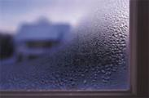
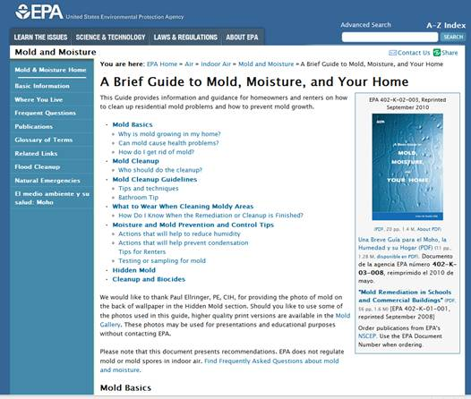
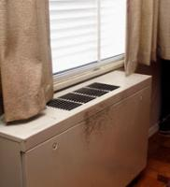
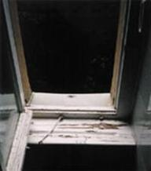
CONDENSATION & MOLD
From: http://www.epa.gov/mold/

Slide 29
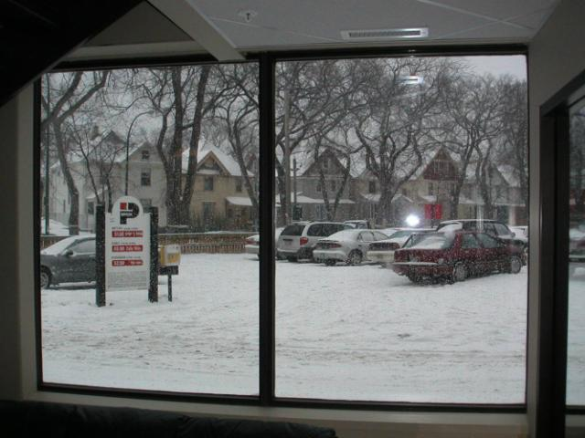
FIBERGLASS CONDENSATION FREEDOM
ASHRAE “Winter” Glass Temp: 64 ºF
Lower Frame Corner: 54 ºF(?)

Slide 30
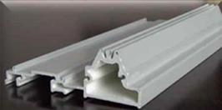
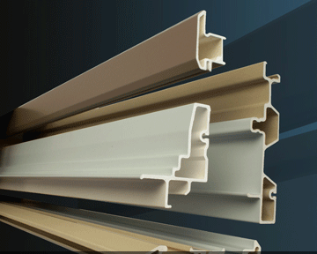
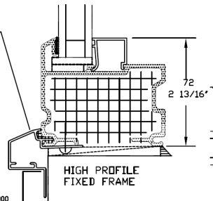
FIBERGLASS WINDOW SASH/FRAME CROSS SECTION
TectonProducts.com
InlineFiberglass.com
OmniGlass.com

Slide 31
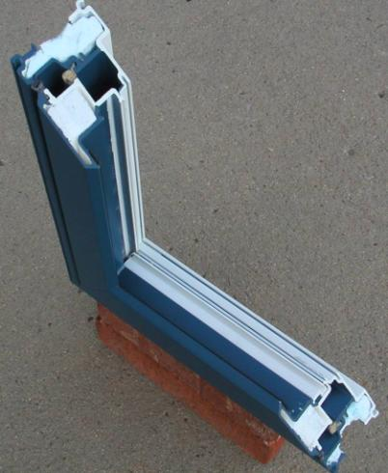
FIBERGLASS CROSS-SECTION
Pultrusion Lineal Mechanical Corner Sash
Pultrusion “End” (Al Dueck – Duxton)

Slide 32
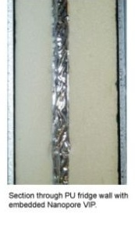
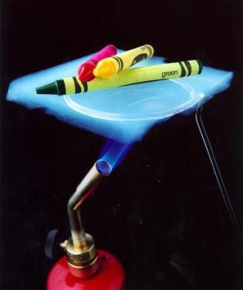
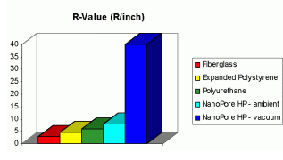
VACUUM SILICA BASED SASH/FRAME R-36 INSULATION
KevoThermal.com - Albuquerque

Slide 33
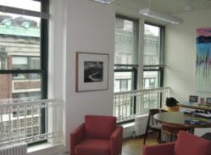
Institutional/Commercial Passive House Presence
NRDC Headquarters - NYC
Morristown Maple Avenue City Building

Slide 34
Passive House Occupant Comfort
Six Human Comfort Factors
\
Air Temp
Mean Radiant Temp
Air Velocity
Relative Humidity
Activity Level
Clothing Factor
CFD Modeling
GOOGLE – New York City
20-Degree Surface Temp Difference

Slide 35
INSULATING GLASS ACOUSTICS 101
REPRESENTATIVE STC RATINGS
GLAZING TYPE SOUND TRANSMISSION CLASS (STC)
Conventional Double Pane (1/8”) Glass 29
Solid ½” Gypsum Wall 36
SCF: 1” Overall with ¼” Glass 35
SCF: 1 ½” Overall with ¼” Glass 38
SCF: One Lite Laminated 40
SCF: Two Lites Laminated 43
SCF: Two Dissimilar Laminated Lites 49
SCF: Two "Acoustic“ Laminated Lites 52

Slide 36
WINDOW ACOUSTICS
National Research Council of Canada Inline Fiberglass Window Acoustic Report (STC = 35)
TEST WINDOW:
87 Wide x 72” High
Two large upper fixed
One small fixed and one small awning below
Insulating Glass
Outer: ¼”
Airgap: ¾”
Inner: 3/16”

Slide 37
FIBERGLASS ENVIRONMENTAL FACTORS Research By Enermodal Engineering – Canada
Glass (silica sand): 65 – 85% Ample worldwide supply
Resin: Thermoset Polyester “Relatively small” petroleum content
Process resins: re-blended and reused
Interior sash and frame insulation: polystyrene – petroleum base with some concern for pentane blowing-agent escape
Both glass fiber and resin manufacturing are closed processes with “few emissions to the environment.”
No ozone-depleting chemicals used in fiberglass window manufacturing
Energy efficiency and long life significantly reduce energy consumption
Enermodal Conclusion
Energy use was considered to be the most important environmental factor. From this analysis it was found that fiberglass windows have the lowest overall environmental impact.

Slide 38
IG PERFORMANCE DATA SOURCE
All Thermal, Optical and Ultraviolet IG data is generated by Lawrence Berkeley Laboratory’s “WINDOW 6.3” software.
LBL WINDOWS & DAYLIGHTING GROUP
Berkeley, CA (510-486-6844)
Windows 6.3 (free download)
Website: http://windows.lbl.gov
International IG Performance Standard
1000+ Glass Types As Of 2013

Slide 39
COMMERCIAL FIBERGLASS FRAMES
Internal Anchor Blocks
Winnipeg Church In Blizzard – Warm To The Touch Window Frames

Slide 40
DYNAMIC GLAZING Electrochromic / Photochromic / Thermochromic

Slide 41
BIPV GLAZING Integral PV Cells / Transparent PV

Slide 42
ALASKA PIPELINE ENERGY GOES “OUT THE WINDOW”
Amory Lovins: All of the energy pumped through the Alaska Pipeline each year goes literally “out America’s windows.”

